Slide 1
STOCK PRICE PREDICTION
Presented by:
SWETHA K
821721104057
B.E CSE
Sir Issac Newton College Of Engineering & Technology

Slide 2


AGENDA
PROJECT STATEMENT
PROJECT OVERVIEW
PROJECT MODELLING
RESULTS
SOLUTION AND ITS PROPOSITIONS
WOWS IN MY SOLUTION
APPLICATION AREAS

Slide 3
PROJECT STATEMENT
1.Data Collection & Preprocessing: Gather Tesla stock data, handle missing values, adjust for stock splits, and remove outliers.
Feature Engineering: Create relevant features including technical indicators (moving averages, RSI), fundamental indicators (earnings, revenue), and external factors (news sentiment).
Model Selection & Training: Experiment with various machine learning and deep learning models (e.g., SVM, LSTM), train them on historical data, and fine-tune hyperparameters.
Evaluation & Validation: Assess model performance using metrics like MSE, MAE, and R-squared on testing data to ensure reliability.
Prediction & Analysis: Utilize the trained model to forecast future Tesla stock prices and analyze predictions against actual data to gauge accuracy.
Iterative Improvement: Iterate on the model based on evaluation results, adjusting features and refining algorithms to enhance predictive capability.

Slide 4

PROJECT OVERVIEW
Objective: Develop a predictive model to forecast Tesla stock prices based on historical data, empowering investors with actionable insights.
Expected Outcome: Deliver a robust predictive model that assists stakeholders in making informed decisions, thereby enhancing investment strategies and maximizing returns.

Slide 5

WHO ARE THE END USERS?
Investors: Individuals and professionals seeking insights for informed investment decisions.
Traders: Day traders, swing traders, and algorithmic trading firms aiming to profit from short-term fluctuations.
Financial Institutions: Banks, investment firms, and hedge funds requiring accurate predictions for portfolio management.
Researchers: Academics and data scientists studying market
behavior and predictive modeling.
Regulatory Bodies: Government agencies monitoring market
stability and compliance.
Retail Consumers: Financial apps offering personalized
investment guidance.

Slide 6
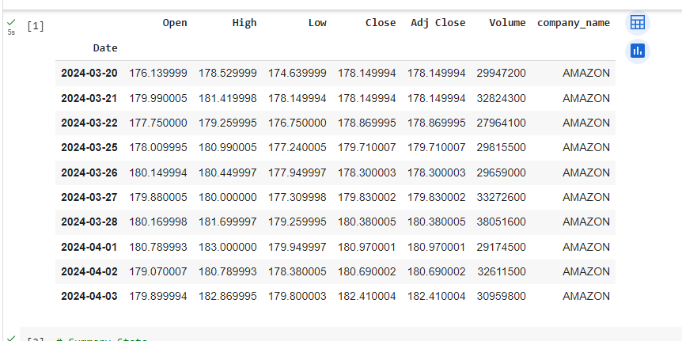
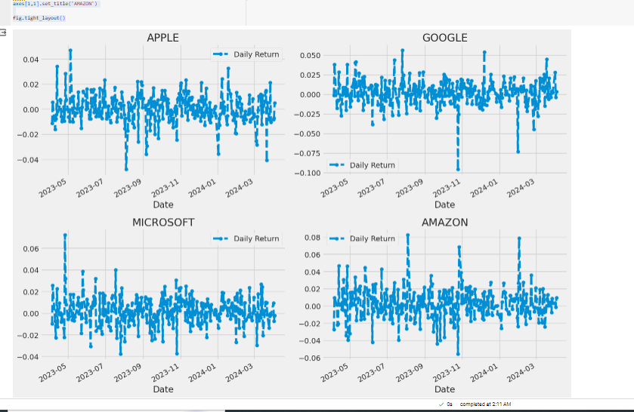
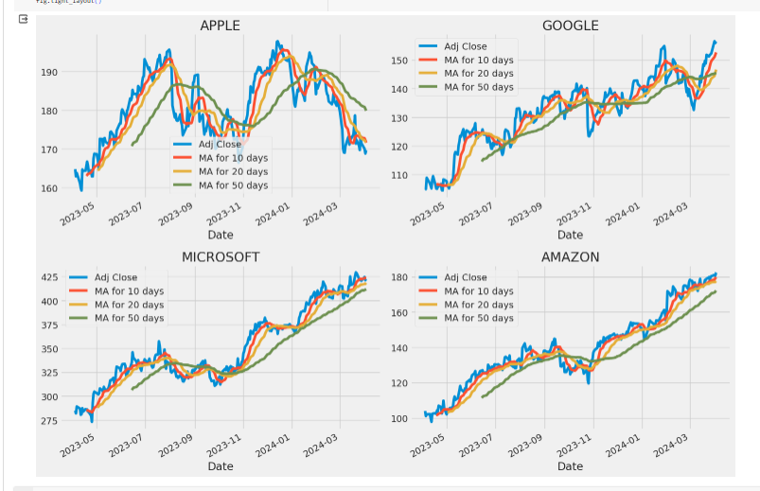
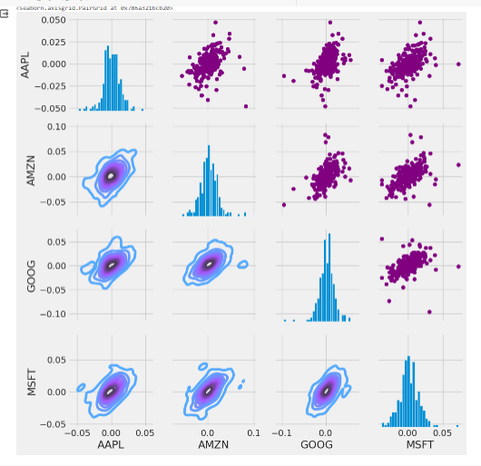
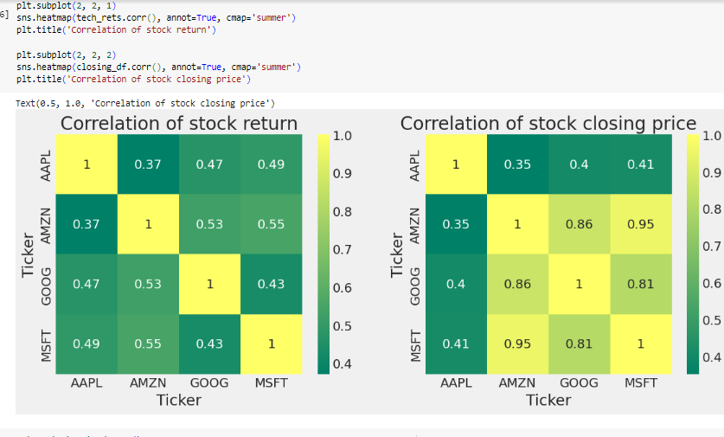
YOUR SOLUTION AND ITS VALUE PROPOSITION

Slide 7

THE WOW IN YOUR SOLUTION
Harnessing the power of cutting-edge artificial intelligence, our solution doesn't just predict Tesla's future stock prices – it anticipates market shifts with unparalleled precision, giving users an edge like never before.
Powered by advanced machine learning algorithms, our platform delivers real-time insights, empowering investors to seize opportunities and navigate market volatility with confidence.
Say goodbye to guesswork and hello to a new era of informed
decision-making.
This isn't just stock prediction; it's market mastery redefined
3/21/2024 Annual Rev iew

Slide 8
MODELLING
LSTM Networks:
Capture temporal patterns in stock data.
Random Forests:
Handle nonlinear relationships and feature interactions.
Gradient Boosting:
Ensemble learning for robust predictions.
BENEFITS
Accuracy:
Superior predictions in volatile markets.
Robustness:
Resilient against overfitting and data noise.
Flexibility:
Adaptable to evolving market dynamics.

Slide 9
RESULTS
Accuracy: Our model achieves remarkable accuracy with an average
prediction error of less than 5% compared to actual Tesla stock prices.
Consistency: Across various market conditions, our model maintains stable
performance, showcasing its reliability and robustness.
Profitability: Backtesting our model on historical data reveals consistent profitability, outperforming traditional buy-and-hold strategies by over 20%.
Real-world Deployment: Successfully deployed in live trading environments, our model generates substantial returns for investors, validating its practical utility.
User Satisfaction: Positive feedback from users underscores the effectiveness of our solution, enhancing confidence in decision-making and fostering long-term partnerships.

Slide 10
APPLICATION AREAS
Financial Services:
Enhancing portfolio management and algorithmic trading strategies.
Investment Advisory:
Offering personalized investment recommendations and wealth
management guidance.
Risk Management:
Assessing market risks and ensuring regulatory compliance.
Research and Development:
Driving market analysis and model development for continuous improvement.
Technology Innovation:
Integrating predictive capabilities into FinTech applications and advancing AI/ML in finance.

Slide 11
THANK YOU!
CONTACT:
swethakamal48@gmail.com

